Slide 1
Best Management Practices for Indiana Karst Watersheds
Notes:
Title slide

Slide 2
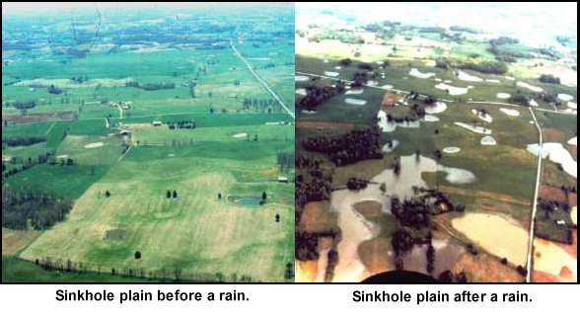
Notes:
Sinkhole peneplain

Slide 3
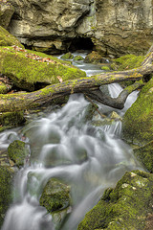
Notes:
Small springs

Slide 4
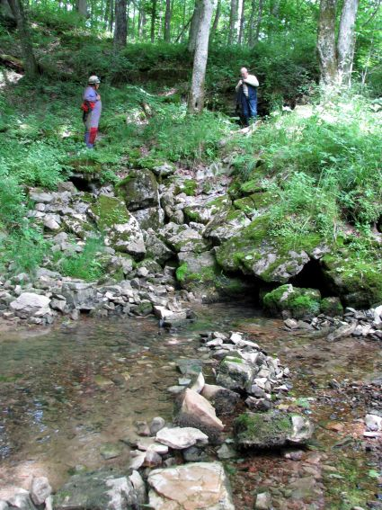
Notes:
Small springs

Slide 5
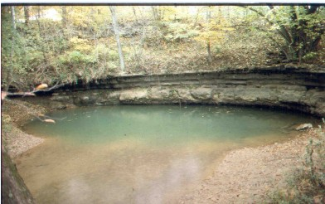
Notes:
Semi-Artisan Springs

Slide 6
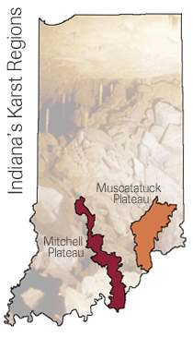
Notes:
Indiana’s Karst Areas

Slide 7
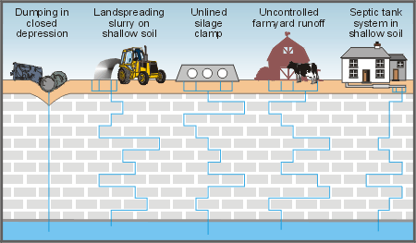
Notes:
Pollution contributions

Slide 8
Notes:
Dye routes

Slide 9
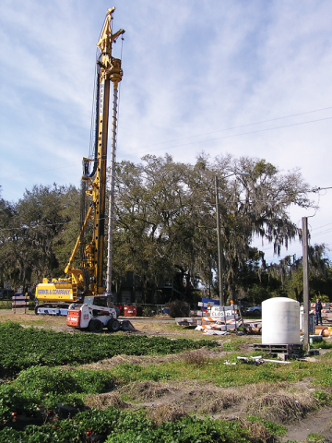
Notes:
Locate ground water table levels

Slide 10
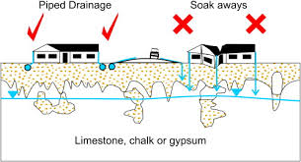

Slide 11
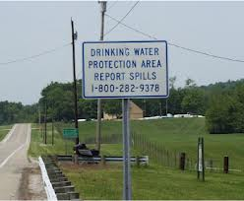
Notes:
Signage

Slide 12
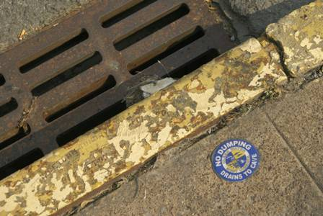
Notes:
Mark known drainage

Slide 13
Notes:
Clifty Environmental map

Slide 14
Notes:
Clifty CFO’s

Slide 15
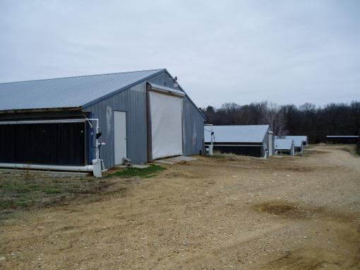
Notes:
Chicken houses

Slide 16
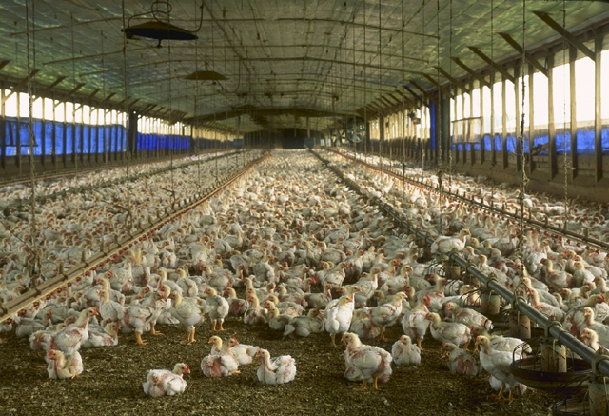
Notes:
Chicken operations

Slide 17
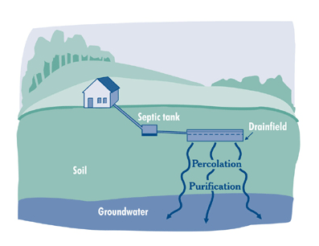
Notes:
Failing private septic systems

Slide 18
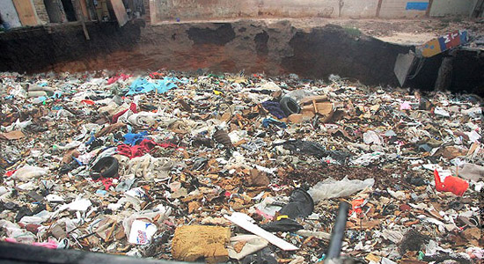
Notes:
Trash in sinkholes

Slide 19
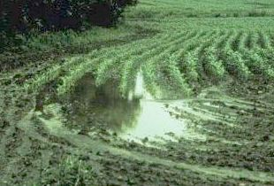
Notes:
Look at drainage

Slide 20
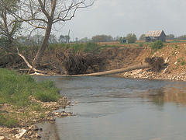
Notes:
Eliminate riparian obstructions

Slide 21
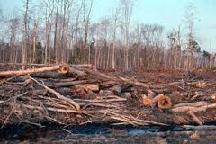
Notes:
Enforce correct forestry standards and practices

Slide 22
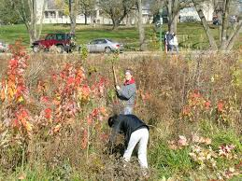
Notes:
Cleaning up sinkholes

Slide 23
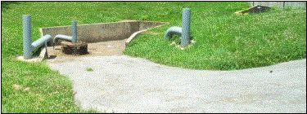
Notes:
Improve drainage patterns

Slide 24
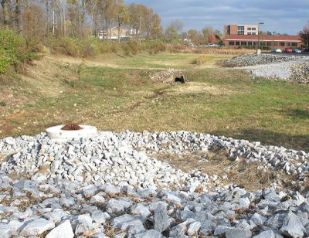
Notes:
Clean and modernize sinkhole drainage

Slide 25
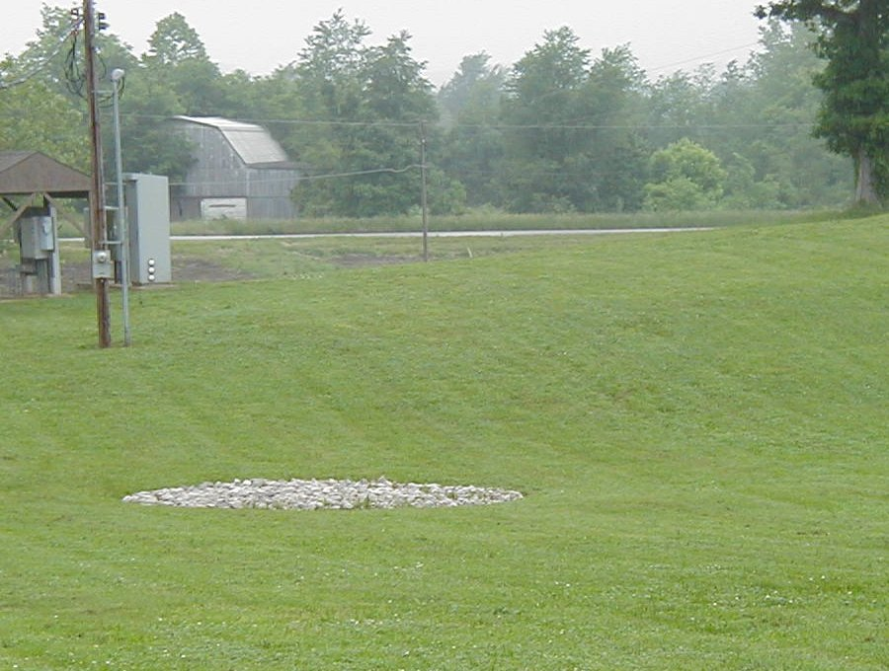
Notes:
Properly repair sinkholes for good drainage

Slide 26
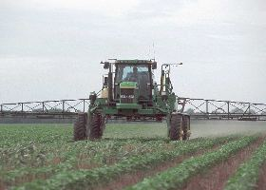
Notes:
Ensure proper use of correct agricultural chemicals

Slide 27
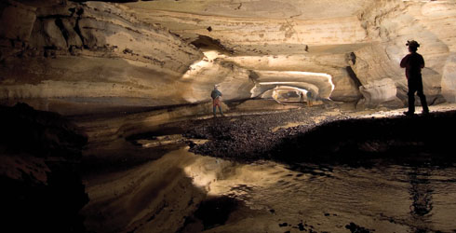
Notes:
Nature’s storm sewer system

Slide 28
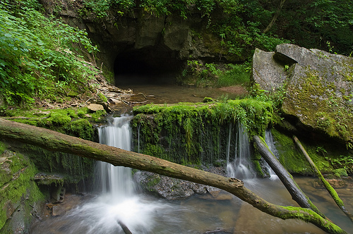
Notes:
This all adds up to cleaner watersheds!

